Slide 1

Hate Crime in the US 2015-2020
Joseph Onwukeme • Kwadwo Asante
Yarely Vargas • Yvonne Martinez

Slide 2
Agenda
• About our data
• Inspirations
• Research questions
01
• Website-Goal
• Website-Viz
• Website-About us
02
• Key Takeaway
• Moving Forward
• Limitations
03

Slide 3
What is Hate Crime

Slide 4
Research Questions
What is the most common hate crime in the US?
What year had the most hate crime?
What state has the most hate crime?

Slide 5



Website walk through
Link here

Slide 6

Inspirations

Slide 7

Key Takeaways
What is the most common hate crime in the US?
Answer research questions

Slide 8
Key Takeaways
What year had the most hate crime?
Answer research questions

Slide 9
Key Takeaways
What state has the most hate crime?
Answer research questions

Slide 10
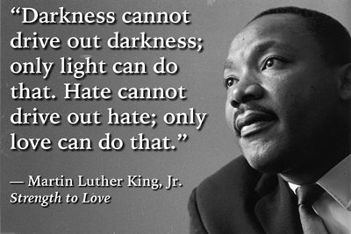

Slide 11

You can help!
More information on hate crime or to help stop hate crime in your community visit the justice.gov/hatecrimes
Notes:
https://www.google.com/url?sa=i&url=https%3A%2F%2Fwww.theredcard.org%2Fnews%2F2016%2F08%2F17%2Fa-worrying-trend-in-hate-crime-statistics&psig=AOvVaw1PwjcZPpXPVKNAe2rg2HyY&ust=1649944577642000&source=images&cd=vfe&ved=0CAoQjRxqFwoTCIi45NeYkfcCFQAAAAAdAAAAABAp

Slide 12
Future Work

Slide 13
Thank you

